Slide 1


Leon County
Post-Disaster Redevelopment Plan

Slide 2
Leon County PDRP Funding
Funded through the Florida Division of Emergency Management to:
Leon County Sheriff’s Office – Division of Emergency Management, Department of Homeland Security funds
Competitive grant awarded to Leon County using Hazard Mitigation Grant Program funds

Slide 3
Notes:
Overarching document is the Comprehensive Plan

Slide 4
Complementary Plans
Leon County Comprehensive Emergeny Management Plan
Leon County Local Mitigation Strategy
Tallahassee-Leon County Comprehensive Plan
City and County Continuity of Operations Plans
Disaster Housing Strategy

Slide 5
Leon County
PDRP Stakeholders
Stakeholders –
  City Agencies
  County Agencies
  Regional Agencies
  Private Business
  Community Organizations
  Non-Profit Groups

Slide 6
Leon County PDRP Focus Group
Growth Management/Land Use
Utilities
Public Works
Health and Human Services
Emergency Management
Economic Development
Builders Association
Building Inspection
Insurance

Slide 7
Goal of the Leon County PDRP
The long-term redevelopment goal is to complete redevelopment efforts within a 3 to 5 year period after the disaster and to restore or enhance a sustainable quality of life for residents through the recovery and redevelopment process.

Slide 8
Structure of the Leon County PDRP
Background Data
  Hazard Identification & Vulnerability Assessment
  Capacity Assessment/Recommendations
  Local Plan Integration
  Finance Strategy

Slide 9
Structure of the Leon County PDRP
  Operational Sections
  Action Plan
  Implementation Plan
  Outreach and Coordination Strategy
  Disaster Housing Strategy – Stand Alone Plan

Slide 10
Hazard Identification and Vulnerability Assessment
Summary of available data from the LMS and CEMP to identify hazards and assess vulnerability
  Hurricanes
  Flooding
  Wildfire
HAZUS-MH 2.0 – FEMA model used to provide economic impact of hazards on Tallahassee/Leon

Slide 11
Property Data
2006 R.S. Means building valuations, there is an estimated 96,877 buildings
Total dollar exposure of over $16 billion
Property Type | Number of Properties | Value (in $1,000 dollars)
Residential | 71,205 | $12,174,373
Commercial | 17,244 | $2,940,634
Government | 2,131 | $372,588
Industrial | 2,034 | $342,449
Education | 1,647 | $278,244

Slide 12
Hurricane Scenarios
Category 1 Hurricane – Makes landfall at Mexico Beach similar to storm of 1877
Category 3 Hurricane – same hurricane strengthened

Slide 13
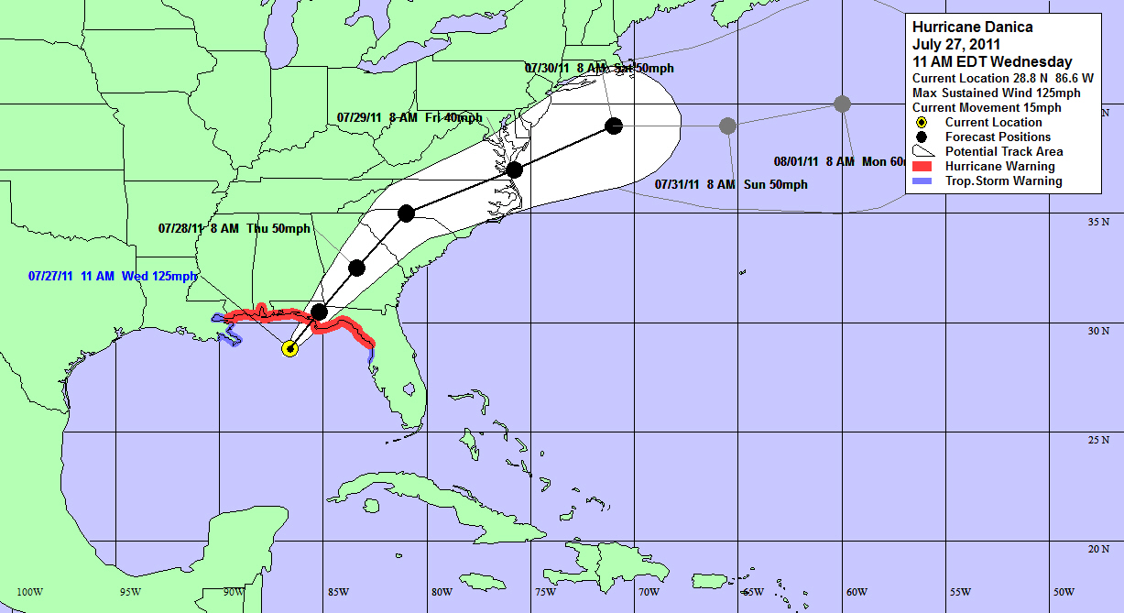
Hurricane Scenario

Slide 14
Projected Loss Category 3 Hurricane
14,000 buildings will be moderately damaged and 325 buildings will be totally destroyed.
Total property damage losses of $1.25 billion
Over 75% of the damage is to residential structures
Property Type | Value
Residential | $815,451,000
Commercial | $155,732,000
Industrial | $19,667,000
Other | $51,642,000
Notes:
65% of $ loss is residential

Slide 15
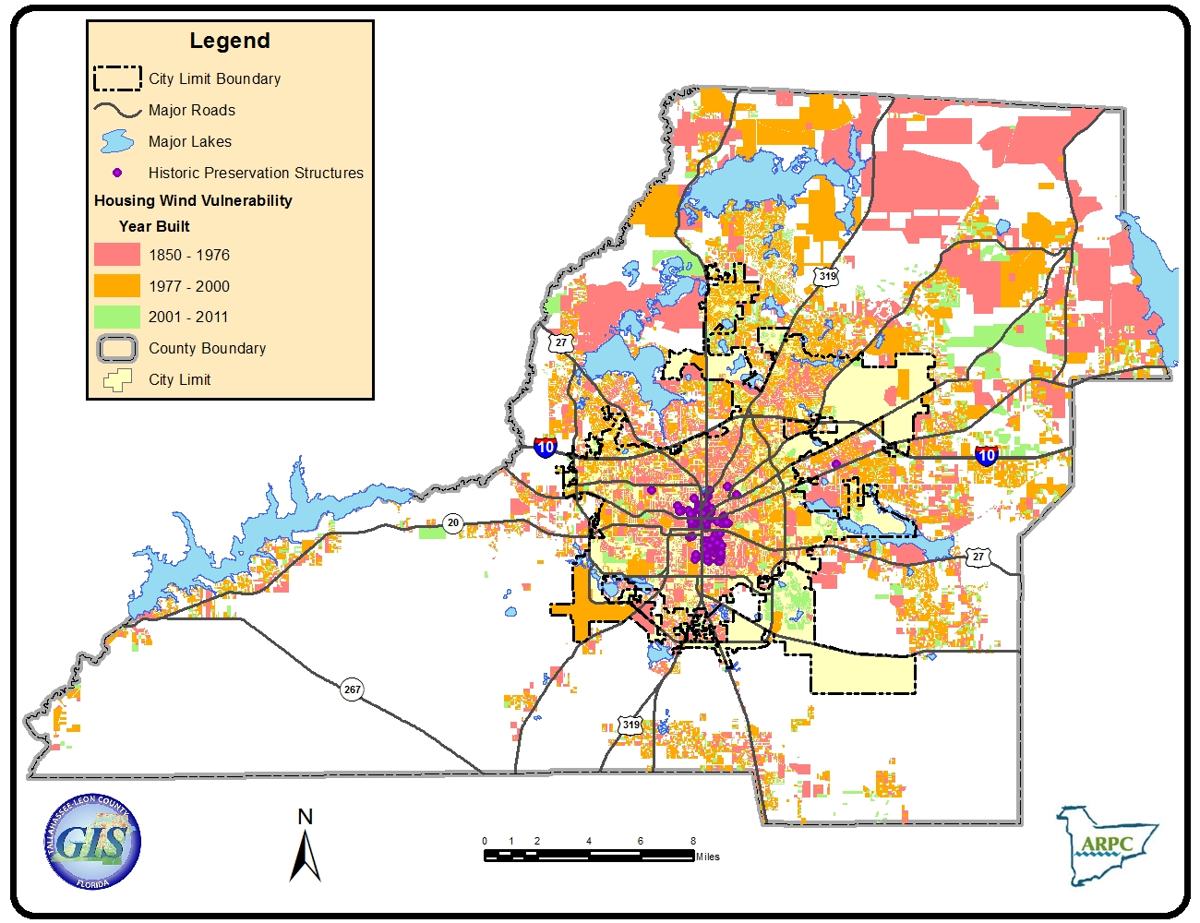
Housing Vulnerability – Leon County

Slide 16
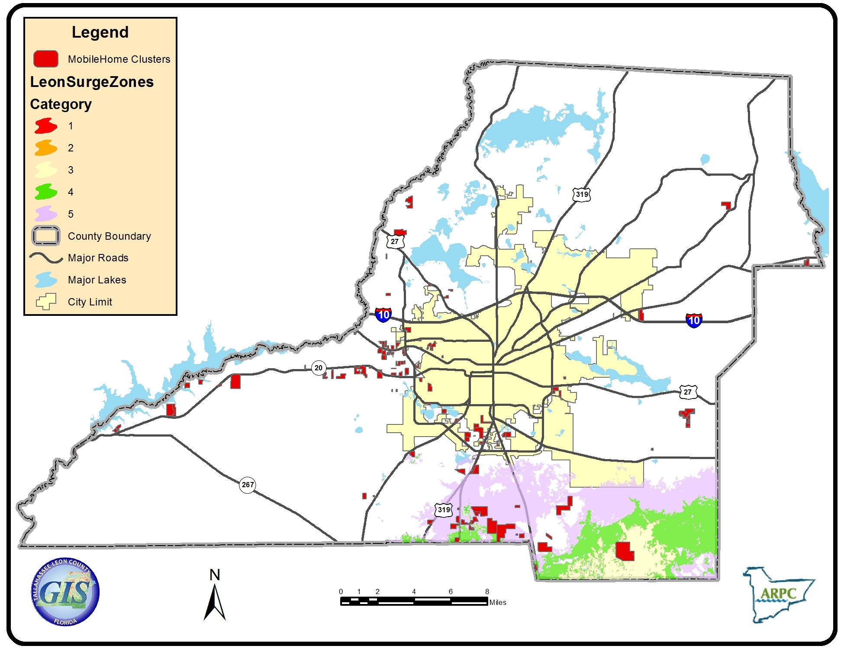
Mobile Home Cluster in Storm Surge

Slide 17
Projected Loss Category 1 Hurricane
766 buildings will be moderately to severely damaged with no buildings being destroyed.
Total property damage losses of $178 million
Over 90% of the damage is to residential structures
Property Type | Value
Residential | $147,949,000
Commercial | $8,443,000
Industrial | $555,000
Other | $1,458,000
Notes:
83% of $ loss is residential

Slide 18
Projected Loss - Flooding
Estimated total economic loss for a 100-year flood event is $269 million
greatest impact is to residential properties which make up 55.73%
Property Type | Loss
Residential | $149,990,000
Commercial | $83,520,000
Industrial | $13,740,000
Other | $20,600,000
Total Direct Economic Loss | $267,840,000

Slide 19
National Flood Insurance Program
10,597 parcels in the 100-year floodplain
$6 billion worth of property and structures with the potential for damage in the event of a 100-year flood event.
Improvement Type | City of Tallahassee |  |  | Unincorporated Leon County
 | Number | Percent | Value ($) | Number | Percent | Value ($)
Residential | 3,987 | 66 | 898,830,073 | 5,066 | 47 | 1,122,274,373
Mobile Home | 81 | 1 | 6,708,908 | 1,387 | 13 | 119,916,427
Commercial | 542 | 9 | 585,061,256 | 112 | 1 | 83,547,102
Other* | 1,439 | 24 | 1,977,811,632 | 4,259 | 39 | 1,235,359,054
Total | 6,049 | 100 | 3,468,411,869 | 4,548 | 100 | 2,561,096,956
Notes:
Federal program that partners homeowners with nearly 90 insurance companies – all same rate. Community must enforce floodplain management standards.

Slide 20
Action Plan
Action Plan
Based on the Capacity Assessment & Gap Analysis
List of Issues & Descriptions
Recommendations
Responsible Agency
Timeframe & Cost
Notes:
Timeframe for completion is the end of March

Slide 21
Implementation Plan
Concept of Operations
Pre-Disaster Implementation
Post-Disaster Activation
Organization
Roles and Responsibilities
Notes:
Long Term Recovery Coordination Group

Slide 22
Disaster Housing Strategy
Mission - In an efficient and coordinated manner provide interim housing and supportive services to the impacted community.
Notes:
Separate workgroup, participation of FDEM, city, county and non-profit agencies

Slide 23
Leon County Disaster Housing Strategy
Provides an overview of the FEMA Disaster Housing Assistance Program
Describes the phases of disaster sheltering
  Emergency shelters
  Transitional shelters
  Interim housing
  Permanent housing
Concept of Operations
Notes:
Concept of Operations names Disaster Housing Team and Disaster Housing Coordinators

Slide 24
Phase | Shelter 0-21 days | Transitional Up to 60 days | Interim Housing Up to 18 months | Permanent 18 months >
Housing Types | Friends & Family Shelters Hotel/Motel | Friends and Family Hotel/Motel Apartments/Rental/Seasonal Housing Travel Trailers Mobile Homes Commercial Space | Apts./ Rental Housing / Seasonal Travel Trailers Mobile Homes Community sites | Lease or purchase of Single Family Multi-family Mobile Homes
Resources | Insurance ARC & voluntary and faith-based organizations State/Local Government US Army Corps of Engineers Blue Roof or similar emergency repair program | Insurance FEMA housing assistance: Repair grants Replacement grants Rental grants Hotel/Motel Vouchers American Red Cross/Others | Insurance FEMA housing assistance: Repair grants Replacement grants Rental grants Direct Housing Local Gov’t/ Wrap around services Nonprofit, Voluntary and faith-based organizations | Private Insurance FEMA Other Needs Assistance (ONA) SBA Loans HUD VA USDA Rural Development Replacement grants Rental grants Voluntary and faith-based organizations Unmet Needs Committee

Slide 25
Leon County PDRP Website
Keep informed by visiting the website – www.leoncountyfl.gov/pdrp
PDRP Coordinator – Susan Poplin 891-6446
ARPC – Denise Imbler 488-6211

Slide 26
Questions?

